Slide 1
COSC 2430 Data Structures Fall 2018
Lab Session1

Slide 2
Outline
Java IDE
Debug and Run a Java program (eclipse)
Debug and Run a Java program (command line)
Avoiding Hard-Coding
Read and write from/into a text file
Homework submission on Linux Server

Slide 3
Java IDE:
eclipse (Windows, Mac OSX , Linux)
https://www.eclipse.org/downloads/
IntelliJ IDEA- Community Edition (Windows, Mac OSX , Linux)
https://www.jetbrains.com/idea/download/

Slide 4
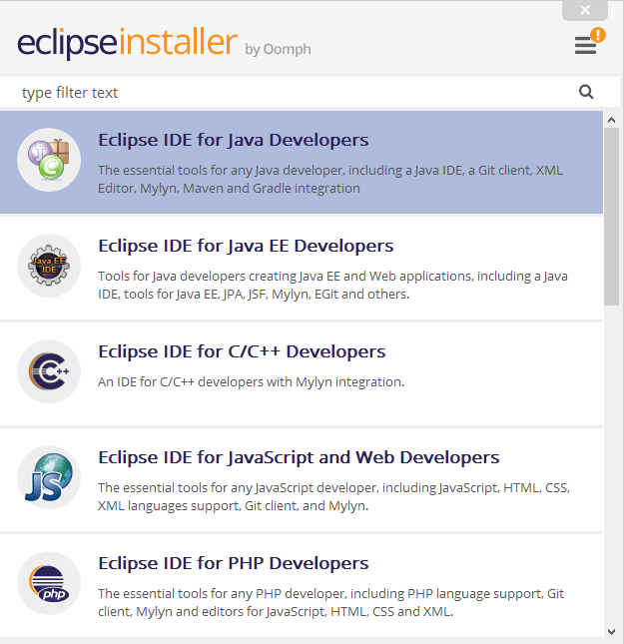
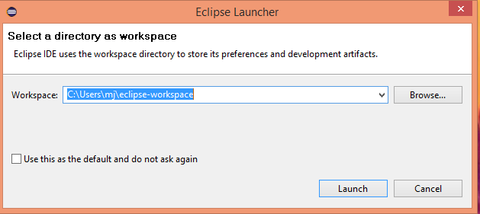
Java IDE: Install eclipse
Specify a workplace where you want to have your java projects and files

Slide 5
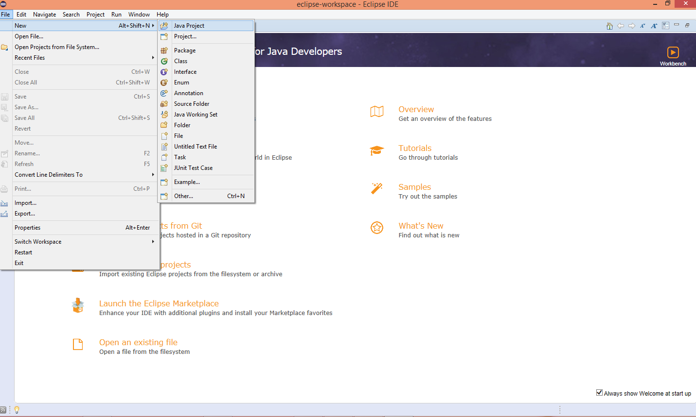
Java IDE: New Java Project
File->New -> Java Project -> Project name

Slide 6
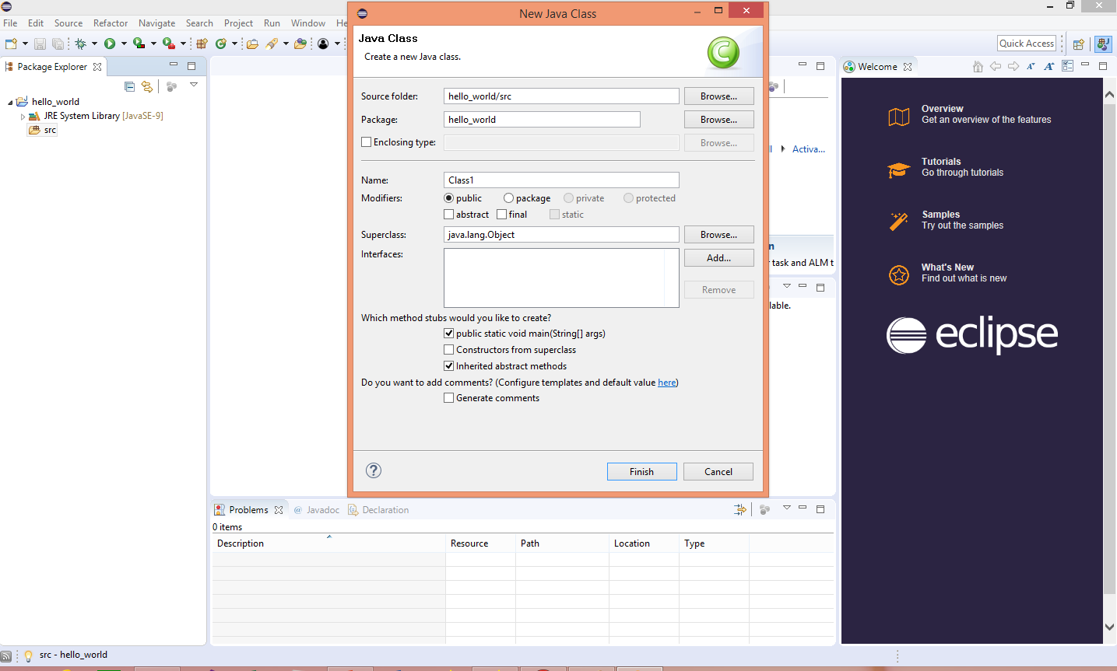
Java IDE: New Java Class
Package Explorer -> Project name -> right click -> New -> Class

Slide 7
A Simple Java Program:
public class Class1 {
public static void main(String[] args) {
// TODO Auto-generated method stub
System.out.println("Hello World!");
}
}

Slide 8
Run and Debug Java program (eclipse):
To run:
Run -> Run OR Ctrl + F11
To Debug:
Run -> Debug OR F11
What is Debug for ?
To run the program line by line and see its intermediate results!
Debugging is the process of finding and resolving defects or problems within a computer program that prevent correct operation of computer software or a system (Wikipedia)

Slide 9
Run and Debug Java program (eclipse):
To see intermediate results in debug mode:
Make a breakpoint!
Double click on a specific line that you want to jump into it
Press F11 for Debug mode
The highlighted line is the current line that is being run
Press F6 for Step Over an statement and see its final result
Press F5 for Step Into an statement ( e. g. a function call) and debug it line by line (if it is a function call)
On the right side you can
See variables with their values
Write a valid expression and see its result Immediately

Slide 10
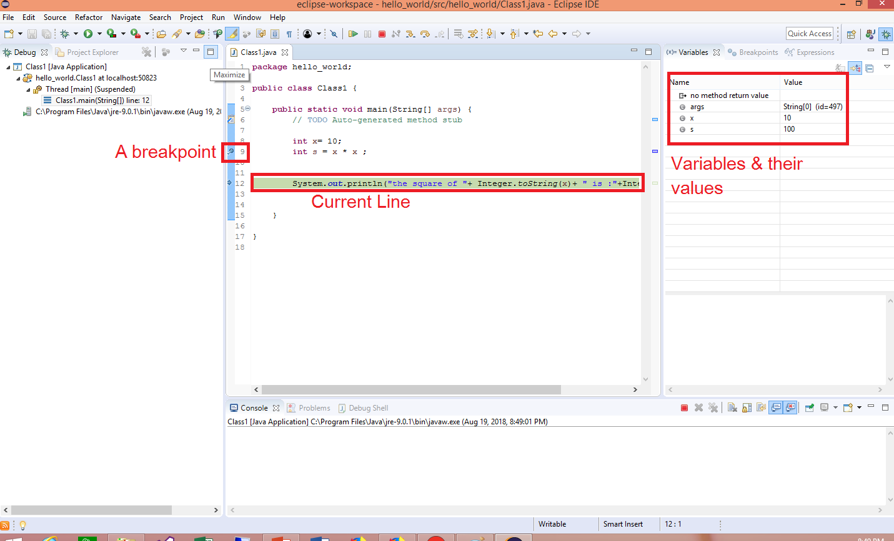
Run and Debug Java program:

Slide 11
Run Java Program from command Line:
To compile:
Javac filename.java
OR
Javac *.java ( if you have multiple java files)
To run:
Java filename

Slide 12
Avoiding Hard-Coding
What if we want to see the square of any int value?
public class Class1 {
public static void main(String[] args) {
// TODO Auto-generated method stub
int x= 10; -> Not quite useful!
int s = x * x ;
System.out.println("the square of "+ Integer.toString(x)+ " is :"+Integer.toString(s));
}
}

Slide 13
Avoiding Hard-Coding
What if we want to see the square of any int value?
public class Class1 {
public static void main(String[] args) {
// TODO Auto-generated method stub
int x= 10; ----> int x= Integer.parseInt(args[0]);
int s = x * x ;
System.out.println("the square of "+ Integer.toString(x)+ " is :"+Integer.toString(s));}}
We take the first argument from command line : args[0]
Then convert it to an Integer: Integer.parseInt()
Java arguments are separated by space, So:
args[0] : the first argument value
args[1]: the second argument value and so on

Slide 14
Run Java Program with Input arguments:
From command Line:
Java filename arg0 arg1 arg2 …
In previous example:
Java myfiename 11
Output is :
the square of 11 is :121
Using Eclipse:
Run -> Run configurations -> Arguments -> arg0 arg1 … -> Run/Close

Slide 15
Java.io.*
We use Java.io to read and write from/into a file:
To read from a file, line by line:
import java.io.*;
public class Class1 {
public static void main(String[] args) throws IOException {
FileReader fr = new FileReader("./input.txt");
BufferedReader br = new BufferedReader(fr);
String line ;
while( (line=br.readLine()) != null)
System.out.println(line);
fr.close();
br.close();
}
}

Slide 16
Java.io.*
We use Java.io to read and write from/into a file:
To read from a file, line by line:
import java.io.*;
public class Class1 {
public static void main(String[] args) throws IOException {
FileReader fr = new FileReader("./input.txt");
BufferedReader br = new BufferedReader(fr);
String line ;
while( (line=br.readLine()) != null)
System.out.println(line);
fr.close();
br.close();}}
Raises meaningful exceptions (e.g. File Not found!)
Path to the input file
Reads line by line to the end of the file (null)

Slide 17
Java.io.*
To write into a file:
import java.io.*;
public class Class1 {
public static void main(String[] args) throws IOException {
FileWriter fw = new FileWriter("output.txt");
BufferedWriter bw = new BufferedWriter(fw);
bw.write("Welcome!");
bw.newLine();
bw.write("this is our first lab session!");
bw.close();
fw.close();}}
Never forget to close File and Buffer reader/writer!

Slide 18
Java.io.*
To write into a file:
import java.io.*;
public class Class1 {
public static void main(String[] args) throws IOException {
FileWriter fw = new FileWriter("output.txt");
BufferedWriter bw = new BufferedWriter(fw);
bw.write("Welcome!");
bw.newLine();
bw.write("this is our first lab session!");
bw.close();
fw.close(); Never forget to close File and Buffer reader/writer!
}}
The system cannot find the path specified, if the path is invalid!!
Path to the output file

Slide 19
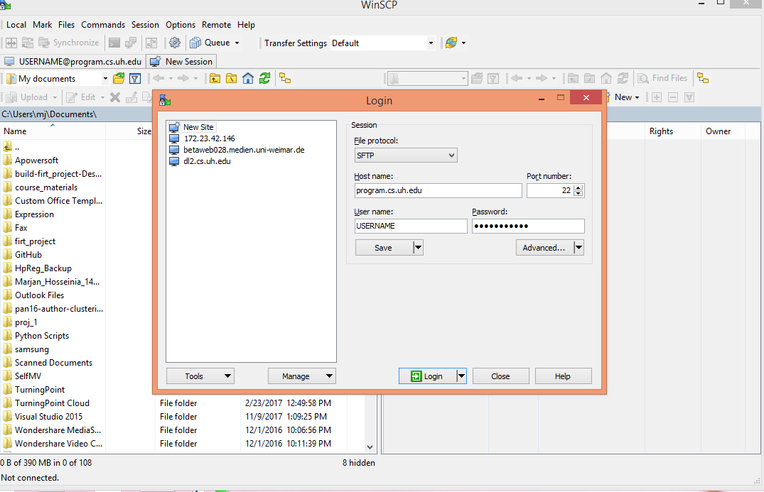
Homework Submission:
WinSCP https://winscp.net/eng/index.php ,SSH (Linux), Putty or …
Host: Program.cs.uh.edu
A pair of username and password will be assigned to you
* Login using your username and password
* Choose your project files
from the left side (your computer)
and drag it to the right side
(Linux server) and upload it.

Slide 20
Run Your Program on Linux Server:
To compile your java program:
sh compile_java.sh
To compile C++ program:
sh compile_cpp.sh
To run your program and compare it with expected output:
sh test_java.sh
You may see Pass/Fail output depending on your results.

